Slide 1
Used- car Price prediction metropolitan cities
By :
RAVINDER SINGH

Slide 2
Objective
We need to scrape the data of used cars from websites (Cars24.) You need web scraping for this. You have to fetch data for different locations. The number of columns for data doesn’t have limit, it’s up to you and your creativity. Generally, these columns are Brand, model, variant, manufacturing year, driven kilometers, fuel, number of owners, location and at last target variable Price of the car. This data is to give you a hint about important variables in used car model. You can make changes to it, you can add or you can remove some columns, it completely depends on the website from which you are fetching the data.
After collecting the data, you need to build a machine learning model. Before model building do all data pre-processing steps. Try different models with different hyper parameters and select the best model.
Follow the complete life cycle of data science. Include all the steps like.
1. Data Cleaning
2. Exploratory Data Analysis
3. Data Pre-processing
4. Model Building
5. Model Evaluation
6. Selecting the best model

Slide 3
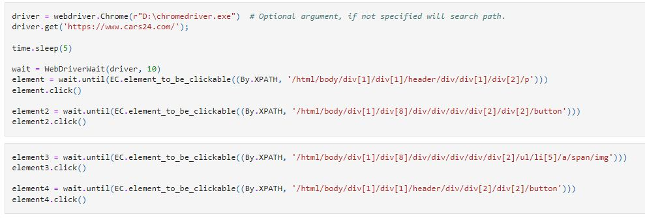
Scrapping (1)
Entering the Website and Selecting the City

Slide 4
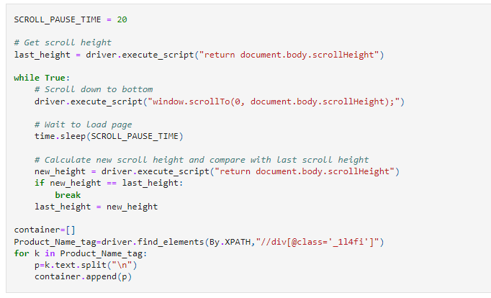
Scrapping(2.)
Infinite Scrolling of the page

Slide 5
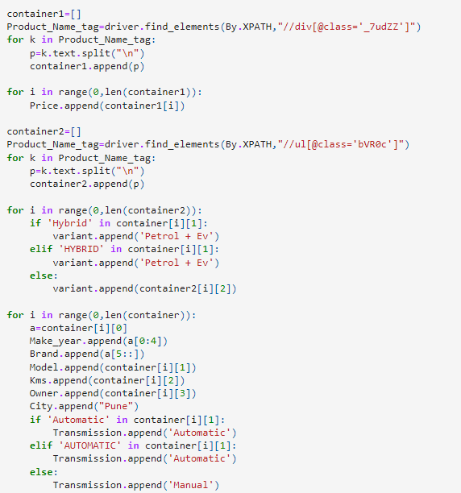
Scrapping(3..)

Slide 6
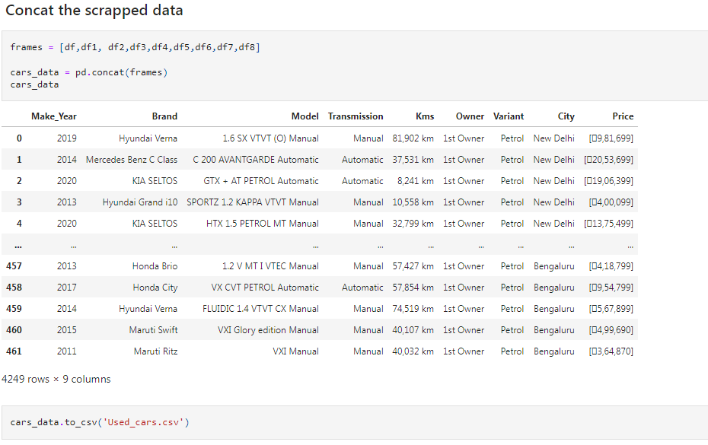
Scrapping (final- result)

Slide 7
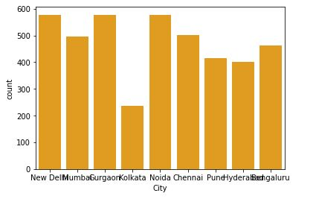
EDA City
Most Number of cars from N.C.R.
Data scrapped is only from metropolitan cities
Hypothesis :Cars 24 more Popular in NCR region

Slide 8
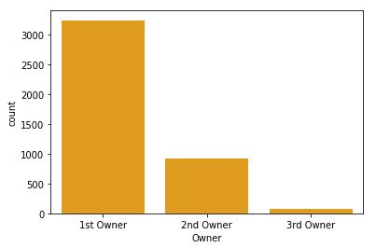
Owner
Majority of Cars had only One owner.
Hyothesis : 2nd Owner are either happy with their vehicle or Cars24 don’t precure a car if the demage is too much (cleared the doubt with Prashant Mundepi [ Senior Manager @ cars24]

Slide 9
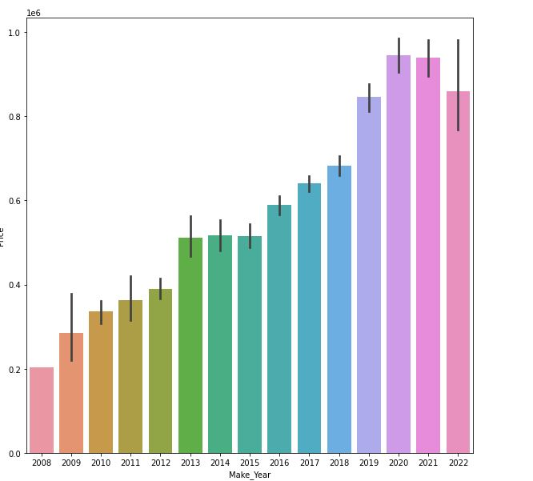
Make Year Vs Price
Price of the car is directly proportional to the age of the car.
But there is a small drop in the price range of cars in 2022.

Slide 10
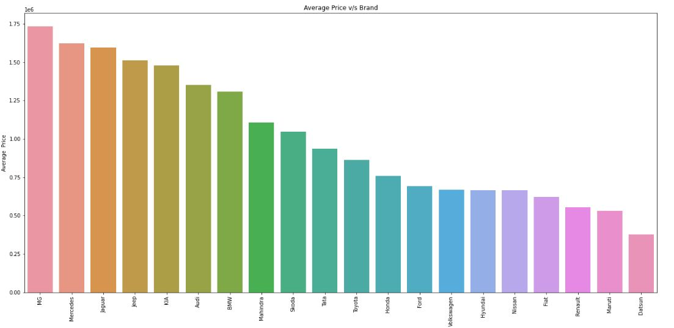
Average Price Vs Brand:
1. Brand like MG,Mercedes, Jaguar,Jeep Kia has a higher resale value
2. Resale value of Fiat, Renault ,Datsun,Maruti is on the lower side

Slide 11
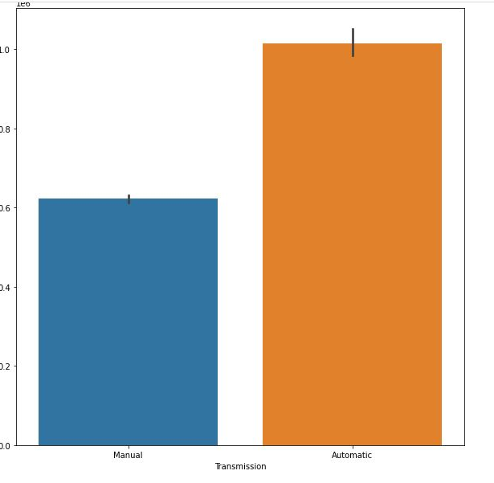
Transmission v/s Price
Majority of the used cars with Automatic Transmission has a higher price.
As the cost of new car with automatic transmission is higher people expect a higher resale value

Slide 12
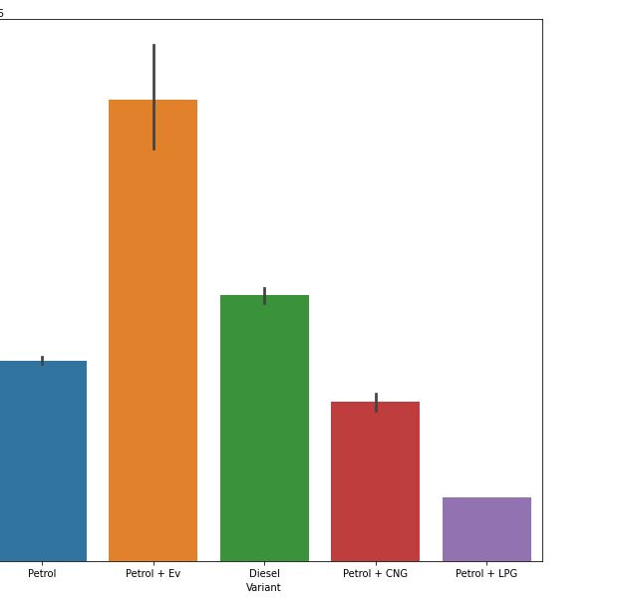
Price v/s fuel type
Cost of Hybrid vehicles is Highest .
Petrol+LPG are priced the Lowest because of the availablity
Hypothesis Semi-Conductor shortage has spiked the price of electric vehicles

Slide 13
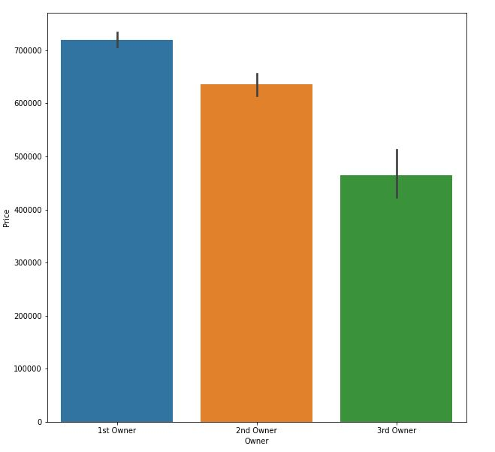
Price v/s oWNERSHIP
Price of the vehicle depreciate as the number of Owners for a vehicle increases.
Inversely Proportional

Slide 14
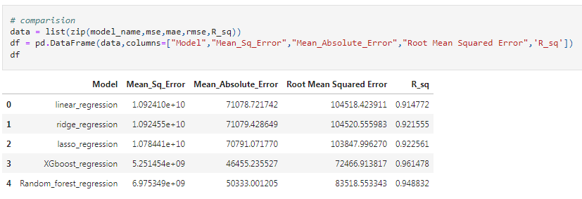
Comparision of Different Models
All the Models Performed very well.
Xgboost and Random Forest Performed on well
We will pick Xgboost out all of them.

Slide 15
Limitation
Demage on the Car is Unknown.
Condition of interior and Electronic of the Car is unknown.
Other Quality Parameters are also unknown.
Data is from Metropolitan Cities
Assumption is that data has linear relation but as we can see that Xgboost and Random Forest perform better than the Linear Algorithms which proof that the one factor has quadratic or cubic relation.

Slide 16
Observations
The price of car is inversely proportional to the age of the vehicle.
Brand like MG ,Mercedes , Jaguar , Jeep, Kia has a higher resale value.
Resale value of Fiat, Renault ,Datsun,Maruti is on the lower side.
Price of the vehicle depreciate as the number of Owners for a vehicle increases.
The large portion of used car are from NCR
Automatic Transmission Cars cost on higher Side.
Cost of Hybrid (Petrol + Ev) vehicles is Highest .
Petrol + LPG are priced the Lowest because of the availability

Slide 17
Thank you
REFRENCES:
Refer the ipynb file for better understanding
https://github.com/Ravinder-Singh-1993/Car_price_prediction/blob/main/Car_Price_prediction.ipynb

